Slide 1
Quadratic Regression
By, Tyler Laufersweiler

Slide 2
Quadratic Regression
Title: Finding the equation of curves throughout
life using quadratic regression
This lesson uses a graphing calculator and Geometer’s Sketchpad to find the function of curves throughout the world. This hands-on lesson allows students to explore quadratic regression using their calculators (quadratic regression applet). Students will use Geometer’s Sketchpad to record data points and their calculators or a website to generate a quadratic function using the data that represents the curve.

Slide 3
Quadratic Regression
Goal:
Students will generate a quadratic function given data that represents a parabola.
Objectives:
Given a picture of a curve, students will plot points of the curve and fill in a table.
Given data points, students will input data into a graphing calculator and use the graphing calculator to perform a quadratic regression.

Slide 4
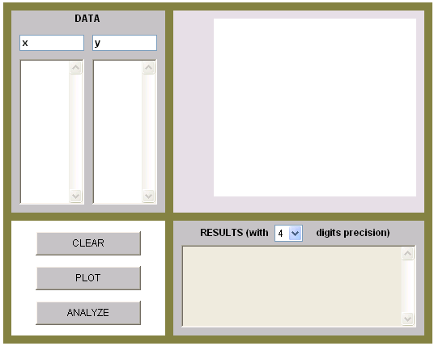
Quadratic Regression
Materials:
Pictures from http://tylerlaufersweiler.weebly.com/curves.html
Geometer’s Sketchpad
Graphing Calculator
Quadratic regression applet http://science.kennesaw.edu/~plaval/applets/QRegression.html

Slide 5
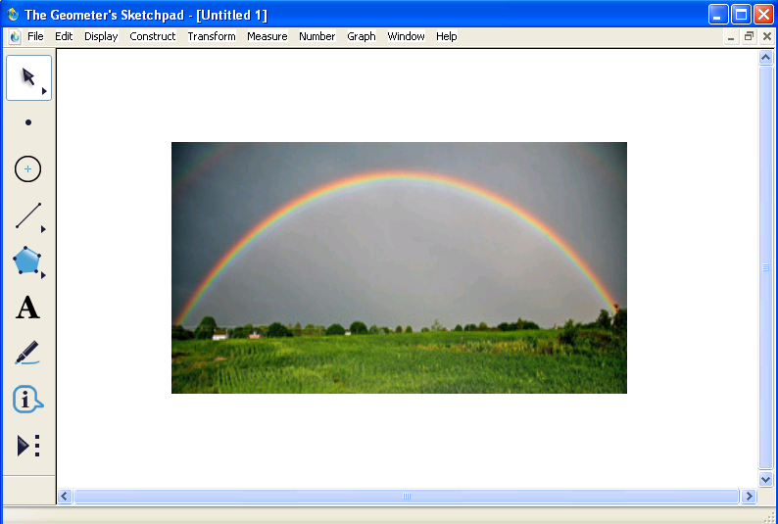
Quadratic Regression
Open geometer’s Sketchpad
Pick a picture from http://tylerlaufersweiler.weebly.com/curves.html.
Copy and Paste the picture into Geometer’s Sketchpad.
Have students predict what their function might look like.

Slide 6
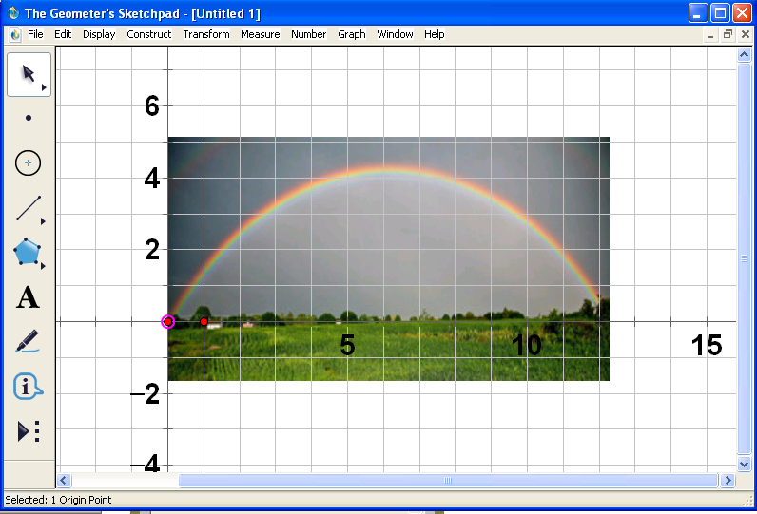
Quadratic Regression
Using the graph menu in Geometer’s Sketchpad, have students insert a coordinate plane.
Move the origin to the appropriate spot of the curve. For example, move the origin to where the water is coming out of the spout, where the rainbow is coming out of the ground, etc.

Slide 7
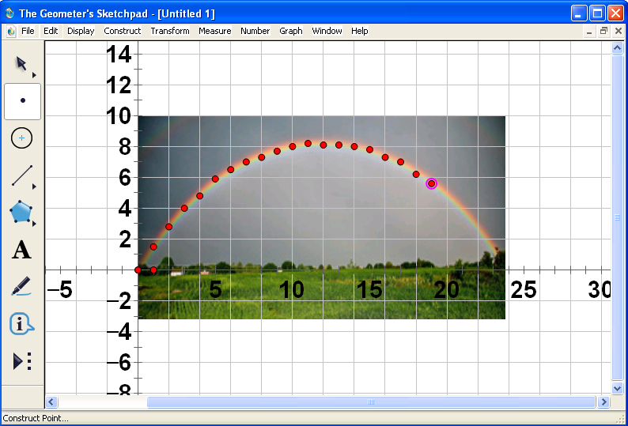
Quadratic Regression
Using the graph menu, have the students plot between 10 and 20 points on the curve. Have them record these points in a table.
x | y
0 | 0
1 | 1.5
2 | 2.8
3 | 4
4 | 4.8
5 | 5.9
6 | 6.5
7 | 7
8 | 7.3
9 | 7.7
10 | 8
11 | 8.2
12 | 8.1
13 | 8.1
14 | 8
15 | 7.8
16 | 7.3
17 | 7
18 | 6.2
19 | 5.6

Slide 8
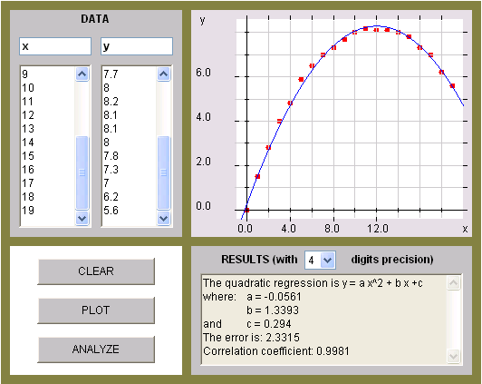
Quadratic Regression
What type of regression would you use for this? A quadratic regression?
Have students input data into the graphing calculator or quadratic regression applet.

Slide 9
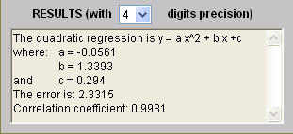
Quadratic Regression
10. Using quadratic regression, have students record their quadratic function.
$$f\left(x\right)=ax^{2}+bx+c$$
$a$ = -0.0561
$b$ = 1.3393
$c$ = 0.294
$$f\left(x\right)=\text{−0.0561}x^{2}+\text{1.3393}x+\text{0.294}$$

Slide 10
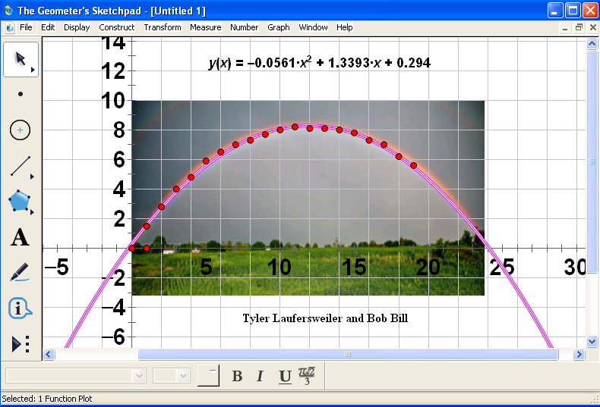
Quadratic Regression
Go back to Geometer’s Sketchpad. Under the graph menu choose plot new function. Have students plot their quadratic functions. The quadratic plotted should follow along the path of the curve in the picture.
Have students type their names on their graph and print them out.

Slide 11
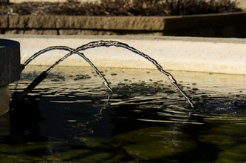
Quadratic Regression
Other curves that can be used

Slide 12
Quadratic Regression
Works Cited
InterMath. (2012, April 26). Retrieved from http://intermath.coe.uga.edu/

